Slide 1


Slide 2
Outline
Preprocessed Training Data
Model Training and Evaluation Part
Ensemble Approach
Summary

Slide 3
Preprocessed Training Data
Summary of Features
'Age', 'Sex', 'SibSp', 'Parch', 'is_alone'
'calculated_fare'
'title_ Master', 'title_ Miss', 'title_ Mr', 'title_ Mrs', 'title_ rare'
'Pclass_1', 'Pclass_2', 'Pclass_3',
'Embarked_C', 'Embarked_Q', 'Embarked_S'

Slide 4
Model Training and Evaluation
After all the preprocessings done, we're ready to train our model with the data.
We choose following models :
Logistic Regression
K-Nearest Neighbors(KNN)
Gaussian Process Classifier
Support Vector Machines
Adaboost

Slide 5
Logistic Regression
Hyperparameter Selection using Random-Search (200 iterations)
'C': 0.054 (Inverse of regularization strength, smaller values = stronger regularization)
'penalty': 'l1'
Selected Features
'Age', 'Sex', 'SibSp', 'Parch', 'is_alone'
'calculated_fare'
'title_ Master', 'title_ Miss', 'title_ Mr', 'title_ Mrs', 'title_ rare'
'Pclass_1', 'Pclass_2', 'Pclass_3',
'Embarked_C', 'Embarked_Q', 'Embarked_S'
Training Set Accuracy: 84.34% (sd: 5.4% 10-fold CV)

Slide 6
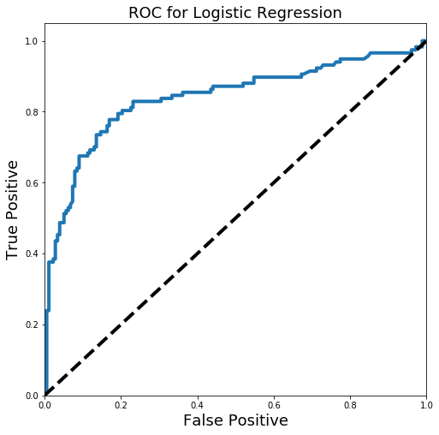
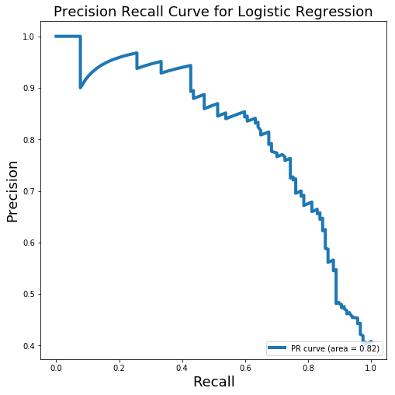
Logistic Regression (Cont’d)
Testing Set Accuracy: 79.25%
ROC_AUC : 0.839

Slide 7
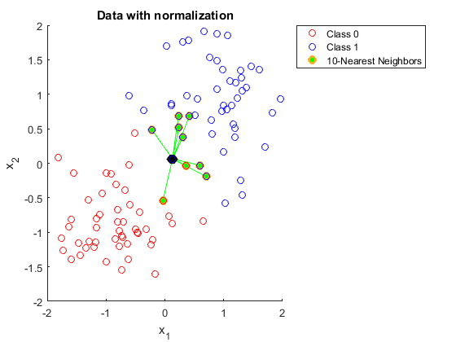
K-Nearest Neighbors(KNN)
The passenger being assigned to the class most common among its k nearest neighbors (k is a positive integer).
Hyperparameter Selection using Random-Search (200 iterations)
'n_neighbors': 13
'weights': 'uniform' is better than 'distance'
Training Set Accuracy: 80.30% (sd: 4.1% 10-fold CV)

Slide 8
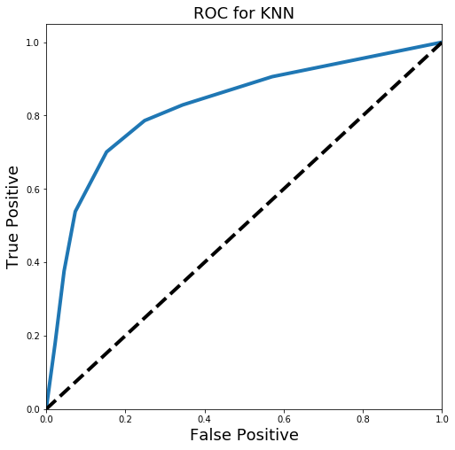
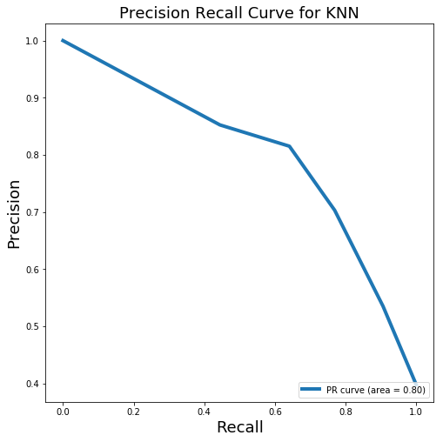
K-Nearest Neighbors(KNN) (Cont’d)
Testing Set Accuracy: 79.93%
ROC_AUC : 0.832

Slide 9
Gaussian Process Classifer
Hyperparameter
GaussianProcessClassifier(copy_X_train=True, kernel=None,
max_iter_predict=100, multi_class='one_vs_rest', n_jobs=None,
n_restarts_optimizer=0, optimizer='fmin_l_bfgs_b',
random_state=None, warm_start=False)
Training Set Accuracy: ? %

Slide 10
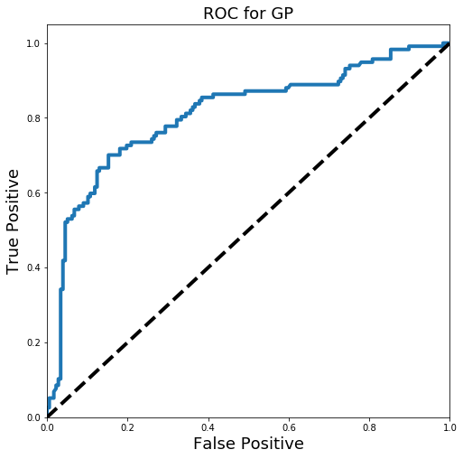
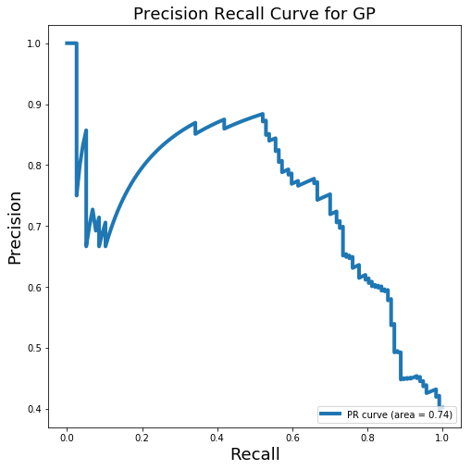
Gaussian Process Classifer (Cont'd)
Testing Set Accuracy: 78.57%
ROC_AUC : 0.8103

Slide 11
Support Vector Machine (SVM)
Hyperparameter Selection using Random-Search (200 iterations)
'C': 9.9016
'gamma': 0.01183
Training Set Accuracy: 84.01% (sd: 4.65% 10-fold CV)

Slide 12
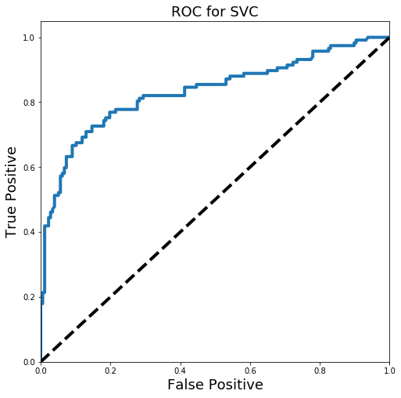
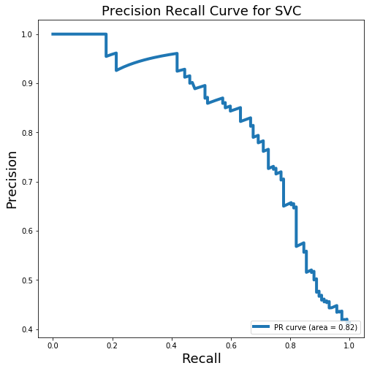
Support Vector Machine (SVM) (Cont'd)
Testing Set Accuracy: 80.27%
ROC_AUC : 0.8339

Slide 13
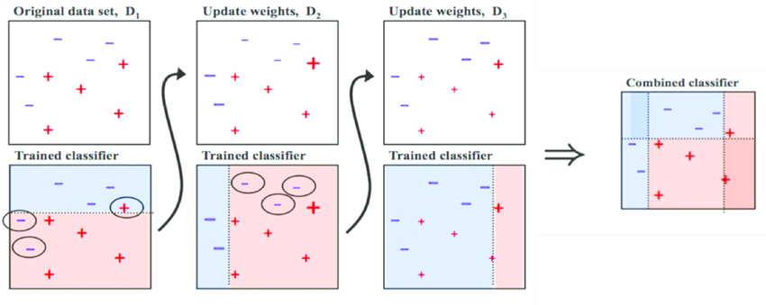
AdaBoost
1. fitting a classifier on the original dataset
2. fits additional copies of the classifier on the same dataset but where the weights of incorrectly classified instances are adjusted such that subsequent classifiers focus more on difficult cases
Hyperparameter Selection using Random-Search (200 iterations)
'learning_rate': 0.7327
Training Set Accuracy: 84.34% (sd: 5.34% 10-fold CV)

Slide 14
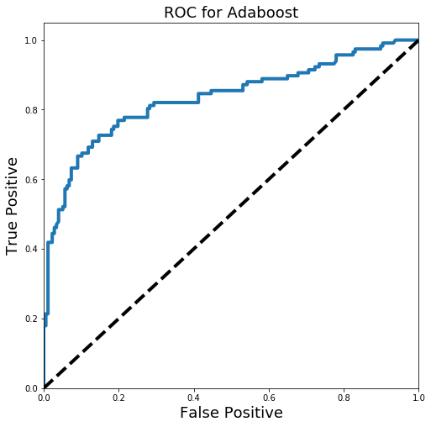
AdaBoost (Cont'd)
Testing Set Accuracy: 80.27%
ROC_AUC : 0.8337

Slide 15
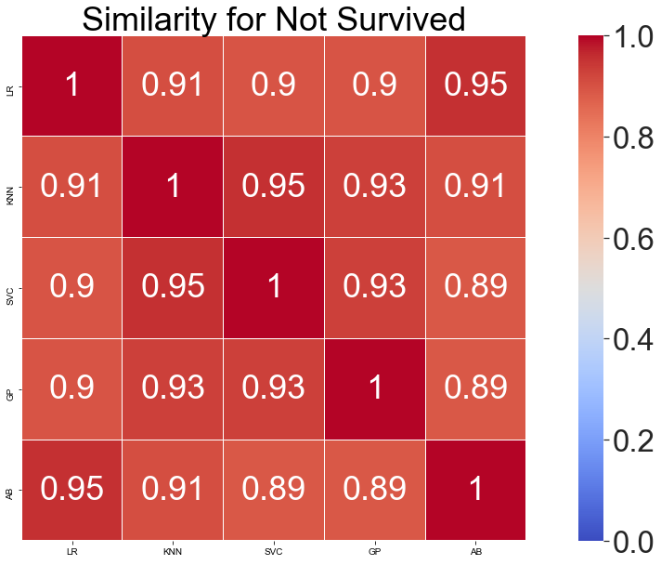
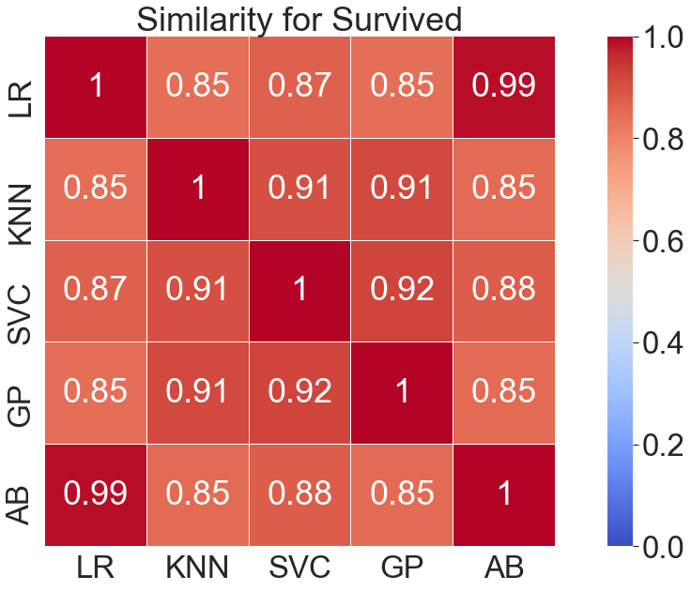
Testing set predictions & Comparisons
The predictions are different between two models.
Appropriate combination of multiple classification algorithm might achieve higher accuracy

Slide 16
Ensemble
Training Results
Model with rank: 1 Mean validation score: 0.8485 (std: 0.0529) Parameters: {'voting': 'hard'}
Model with rank: 2 Mean validation score: 0.8434 (std: 0.0530) Parameters: {'voting': 'soft'}
Testing accuracy : 79.93%
Worse than single model
Try weighting more to the model with higher validation accuracy but obtain same accuracy 79.93%

Slide 17
Summary
Method | Accuracy
Logistic Regression | 79.25%
KNN | 79.93%
SVM | 80.27%
Gaussian Process Classifier | 78.57%
AdaBoost | 80.27%
Ensemble | 79.93%

Slide 18
Conclusion
Ensemble is not always good
Best one **
Existing 80~85% accuracy, hand-crafted features ...

